Slide 1
M6932 Air Traffic Control
Tutorial 1
Date Due: 38th Jan 2020

Slide 2
Exercise 1: Compute hourly demand for Sectors in a given Airspace and
identify overload sector and
sectors that can be merged
Given Inputs:
Airspace structure
Sector Capacity
Hourly Traffic Flow

Slide 3
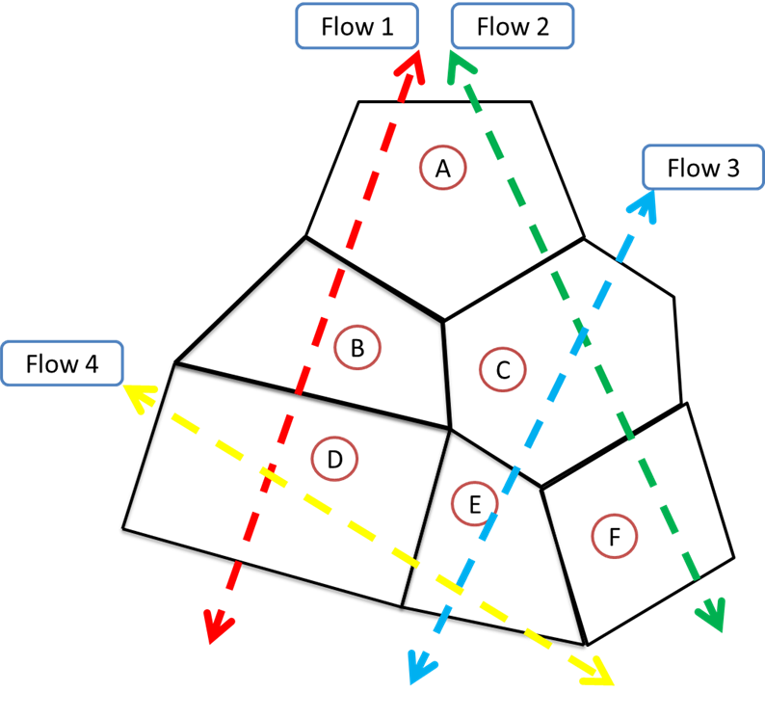
Airspace Structure

Slide 4
Sector Hourly Capacity

Slide 5
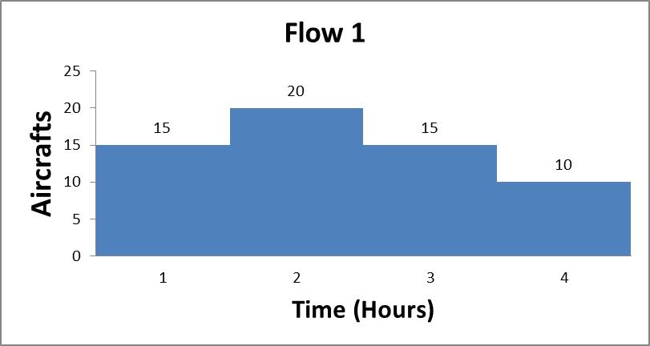
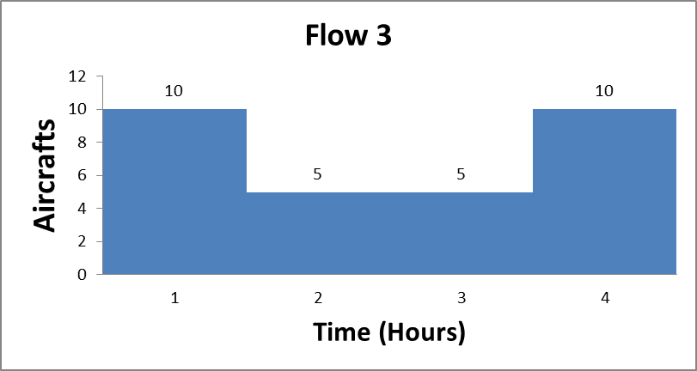
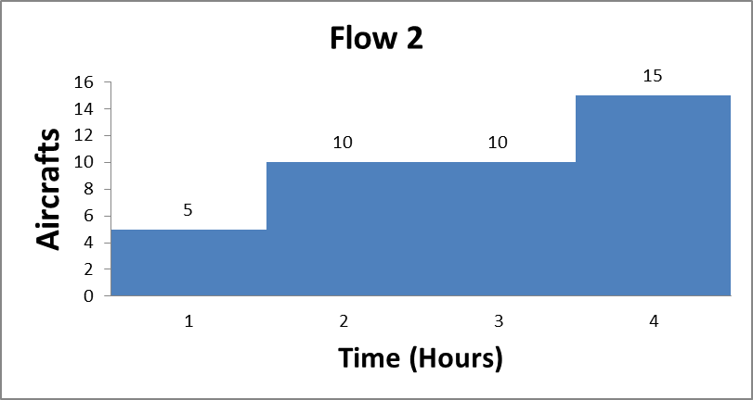
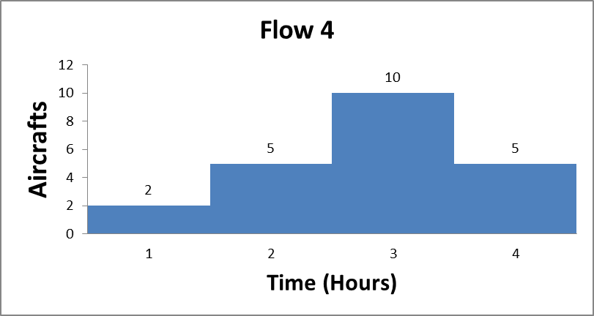
Hourly Traffic Flow of each Airway

Slide 6
Step 1: Compute hourly demand for each sector

Slide 7
Step 2: Determine Capacity vs Demand by inputting
< sign if Demand less than Capacity
> sign if Demand greater than Capacity
= sign if Demand equal to Capacity

Slide 8
Step 3: Identify Overload sector and the time period
Step 4: Identify Underload sector and recommend Merge

Slide 9
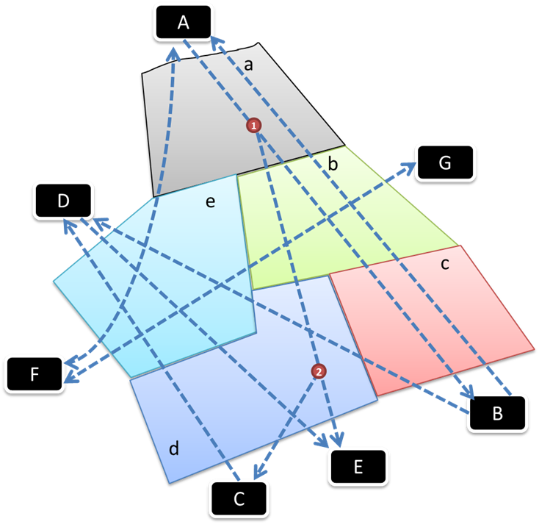
Exercise 2: Compute Traffic load per Airway/Segment and Traffic load per Sector
Given Airports (Origin/Destination): A, B, C, D, E, F, G
Given Sectors: a, b, c, d, e

Slide 10
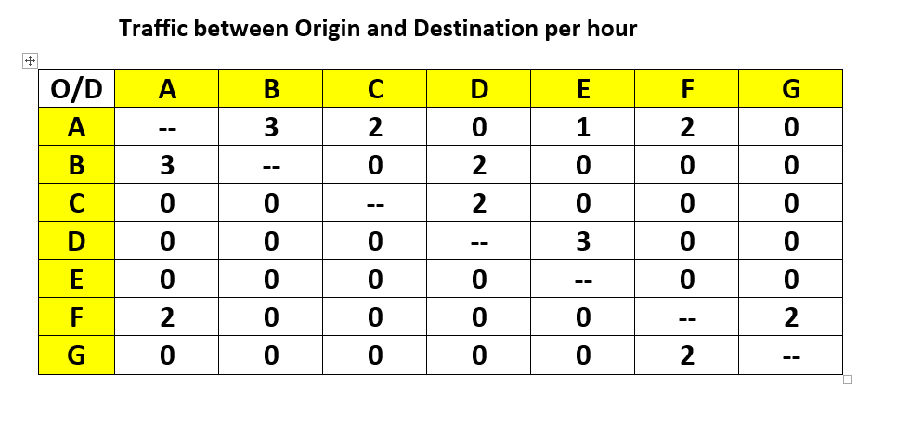
Given: Traffic flow data

Slide 11
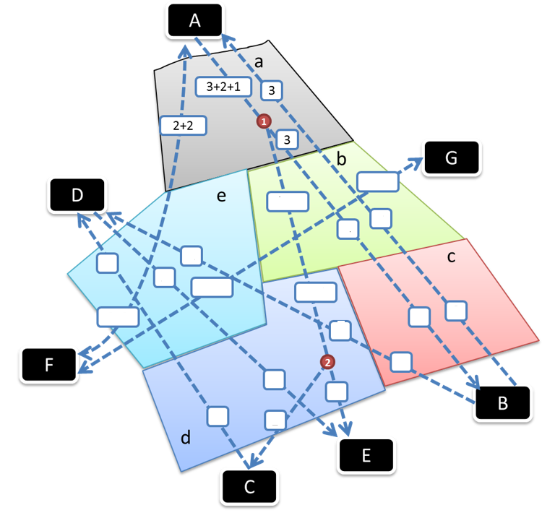
Step 1: Compute Traffic load per Sector per Hour
In Sector a
• (2+2) is Traffic load on A-F
• 3 is the load on B-A
• (3+2+1) is load on A-B, A-C and A-E, which are using same segment (A-1) after which are split in (2+1) and (3) (Avoid double counting the load).

Slide 12
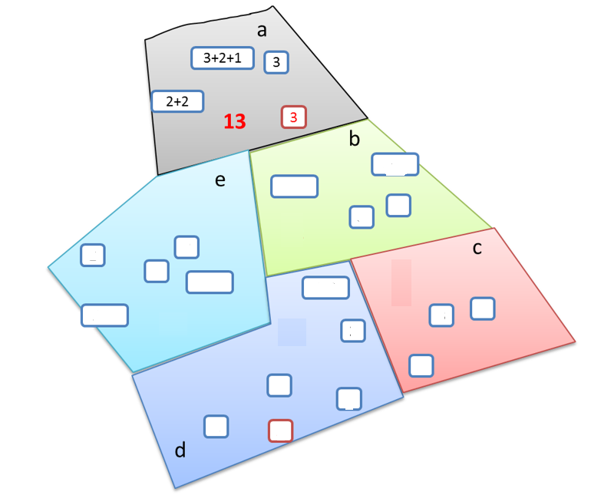
Therefore Traffic load in Sector a per Hour is 13
Compute Traffic load in all other Sectors/per Hour

Slide 13
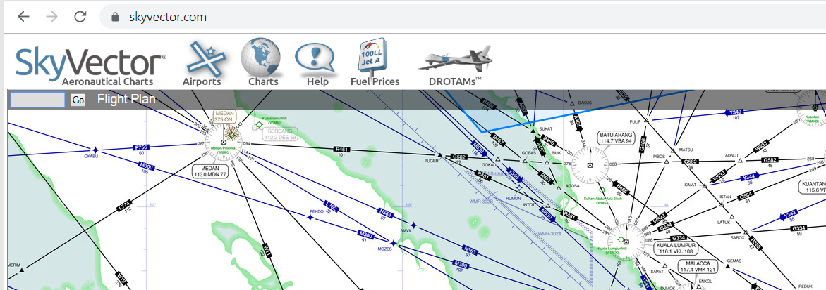
Exercise 3:
Develop a flight plan using SkyVector
WSSS (ICAO letter Airport Code for Singapore)
This will centre the map on to Singapre

Slide 14
Exercise 3:
Develop a flight plan using SkyVector
Click Flight Plan option

Slide 15
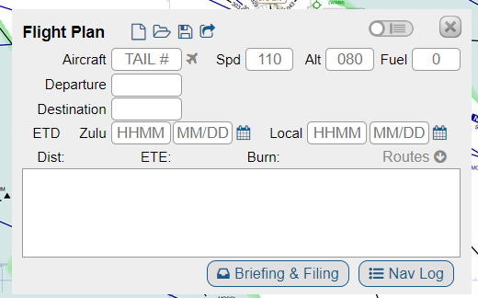
Exercise 3:
Develop a flight plan using SkyVector

Slide 16
Exercise 3:
Develop a flight plan using SkyVector
Departure Airport: Singapore Changi
Destination Airport: Kuala Lumpur International
Speed 140 knots
Altitude 7000 feet
ETD: 1300 08/26
Route:
From Singapore follow departure route to Johar Bahru NavAid VJB,
then follow out bound radial 319 degrees on airway R325,
intercept waypoint REDUK and then.
intercept waypoint SAROX,
turn to airway G334 on inbound radial 274 of VKL navaid,
follow arrival route to Kuala Lumpur International airport.

Slide 17
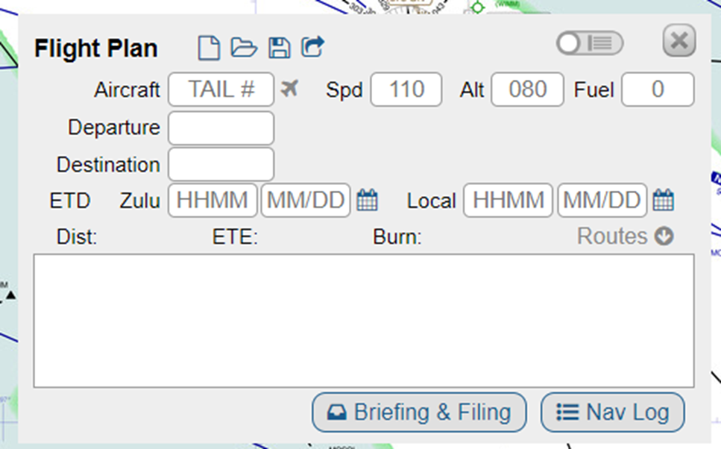
Exercise 3:
Develop a flight plan using SkyVector
Select NavLog and generate Flight Pan
Submit Flight Plan

